Slide 1



Utilizing Machine Learning Methods To Analyze Immunoglobulin Gene Annotations In Epomophorus labiatus
Jesse Gunn Cheu, Ken Field, Ava Hendrix, Brian King, Ashley Reers¹, Lucas Canesin²
1
2

Slide 2
Motivation:
Immunoglobulin loci gene annotations are a tedious and time consuming manual process. How can machine learning provide further insight into this workflow?

Slide 3
Background
Kmer: Pieces of a sequence of a set length.
Class/Target: Category a given sample falls into.
ATG Trimer (3-mer)
GACTGC heptamer (6-mer)
ATGTACTGCTAGCTAGCTACGACTGACTGC
TGT Trimer (3-mer)
TGACTG heptamer (6-mer)

Slide 4
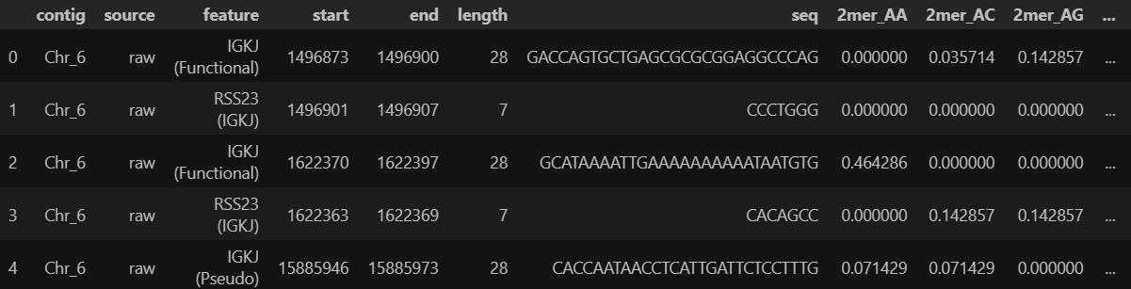
Data
2-mer: 4**2 = 16 columns
3-mer: 4**3 = 64 columns
6-mer: 4**6 = 4096 columns
Kmer count was divided by length in order to focus on the importance of the kmer over the length

Slide 5
Goals
Raw Annotations
Curated Annotations
Can we use kmers as a method of determining if a gene annotation is correct or incorrect?
Are there specific kmers that are important for differentiating correct and incorrect annotations?
What is the feasibility of this becoming a tool to help with the filtering process?
Seqs & kmers
Seqs & kmers
Merged Dataframe
Exploratory Analysis
Logistic Regression
Decision Trees
Accuracy Testing
Conclusions

Slide 6
Gene types of interest
Immunoglobulin Lambda Joining cluster (IGLJ)
Immunoglobulin Lambda Variable cluster (IGLV)
RSS23
L-PART1
L-PART2
L-PART1
L-PART2
J/V
J/V
J/V

Slide 7
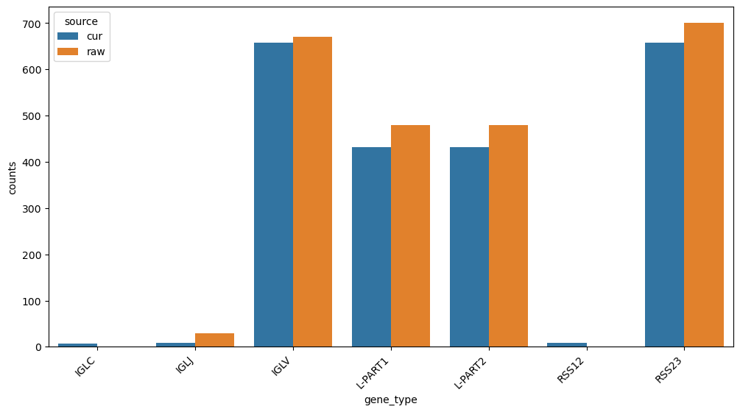

Slide 8
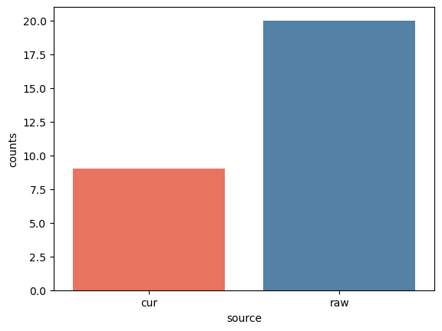
Filtering
Pairwise distances between sequence kmers ( < 1-e10) meant two sequences were the same.
38 IGLJ → 29 IGLJ = 9 duplicates removed

Slide 9
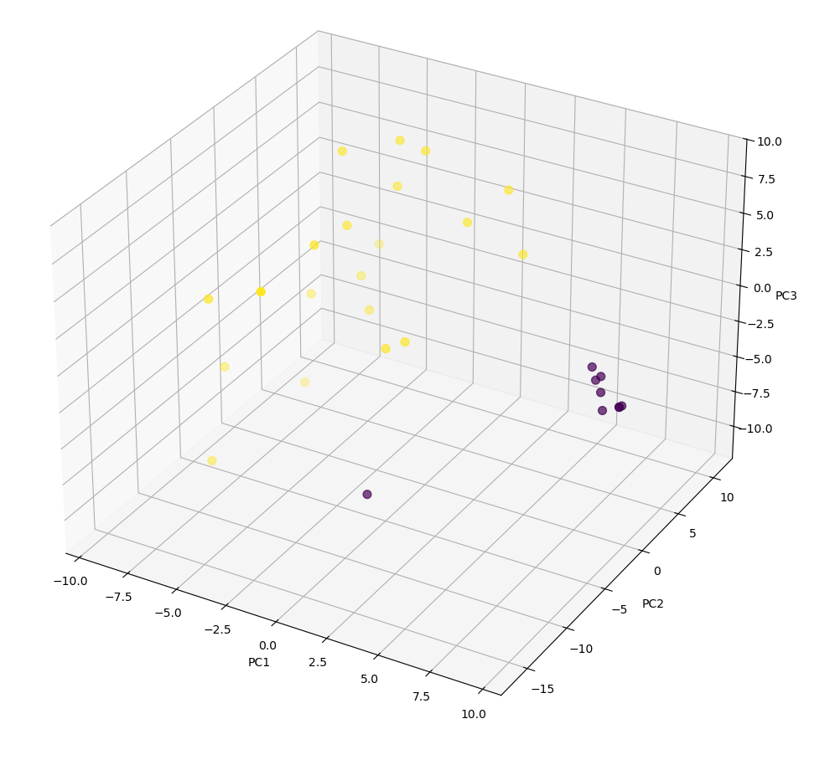
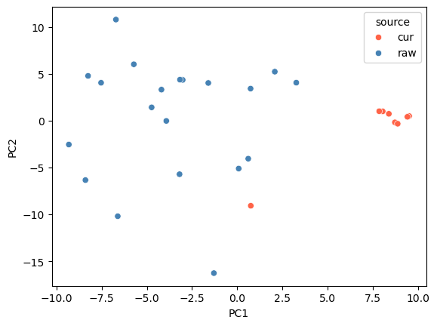
PCA Plots
Here we can determine if there is a clear divide between our two classes

Slide 10
Building Our Classifiers
Seq 124
ATGC = 0.078
TGCC = 0.022
…
Decision Trees
Split the data on key features which can be visualized creating a tree.
Logistic Regression
More powerful for large data but still functions on classifying binary classes (Raw or Curated).
Grid Search
Not a classifier, but a method of refining classifiers via multiple iterations to improve accuracy.
Raw == Not a real annotation
Curated == Real annotation

Slide 11
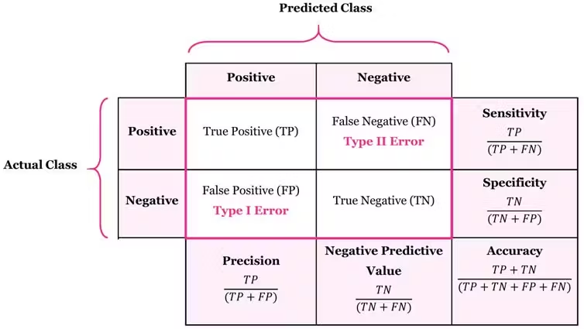
Classifier Metrics Refresher
If we manually curate, false positives are ideal…
ex: If screening for a sickness, better to have a false positive than false negative

Slide 12
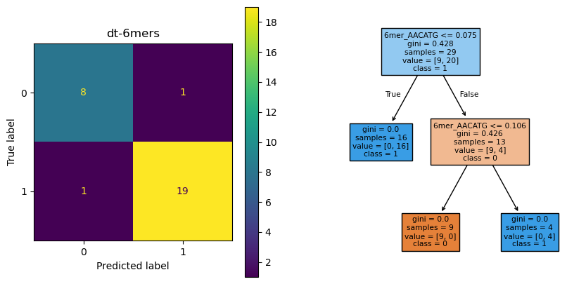
Basic Decision Tree Results

Slide 13
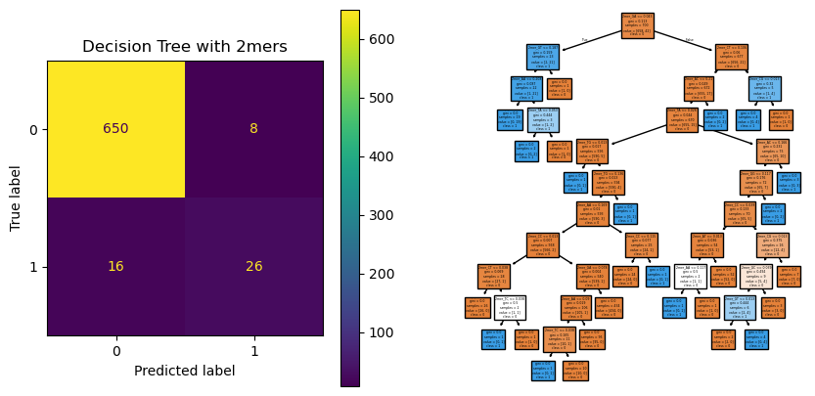
Decision Tree Results RSS23

Slide 14
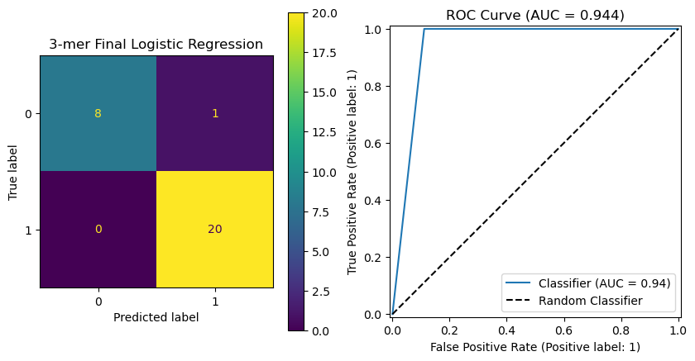
Grid Search Logistic Regression

Slide 15

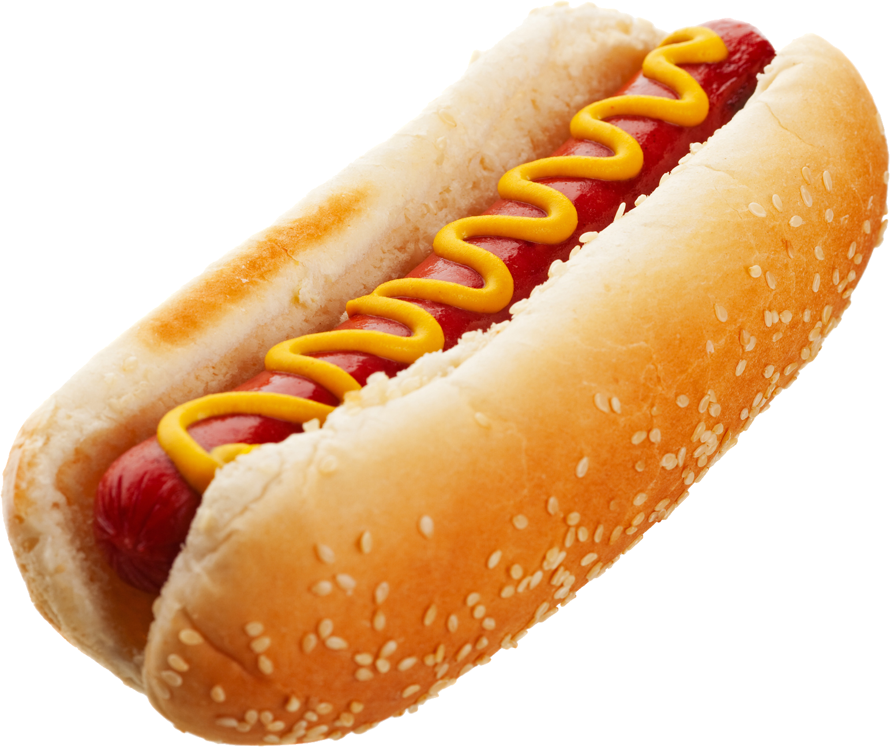
Conclusions
Limitations
Does not take into account sequence location or any other factors…
ATGC on chr 1 == ATGC on chr 12
Relatively small dataset, more data == more general model
Future Steps
More general pipeline
More classifiers (Neural nets)
More specific to IG features
Odorant Receptor
Not Odorant Receptor

Slide 16
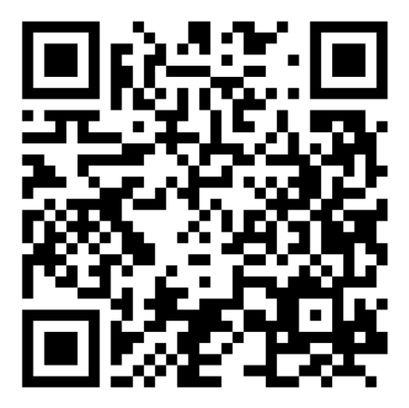
Thank You!
Questions
Github: JesseGunn

Slide 17
Citations
Lees WD, Saha S, Yaari G, Watson CT. Digger: directed annotation of immunoglobulin and T cell receptor V, D, and J gene sequences and assemblies. Bioinformatics. 2024 Mar 4;40(3):btae144. doi: 10.1093/bioinformatics/btae144. PMID: 38478393; PMCID: PMC10957512.

